Slide 1

Identifying shopping centers with high operating loss risk and potential redevelopment opportunities
Mid Point Presentation
Chi Zhang
MUSA, 2022

Slide 2
Background
Risk of operating loss in an oversupplied market
Mismatch of operation value and location value
Since most of operation data is business secret, how can we quantify two questions above with accessible dataset and perhaps foresee the risk before construction?
Notes:
Commercial real estate market in Shanghai is oversupplied because of rising vacancies, current and future shopping malls may face the risk of operating loss.

Slide 3





Goals and values
From the perspective of researchers, government and investors
2
Goals
3
Values
Researchers: Creative application of gravity model
Government: Land use planning and urban regeneration adjustments
Investors: Risk evaluation and seize redevelopment opportunities
Finding out shopping centers with operating loss risk with gravity model and real estate finance formulas. Test the result with social media data.
Analyzing mismatch of operation value and location value with entropy weight method

Slide 4
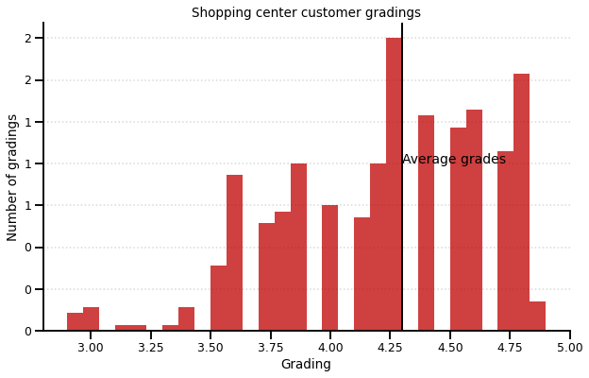
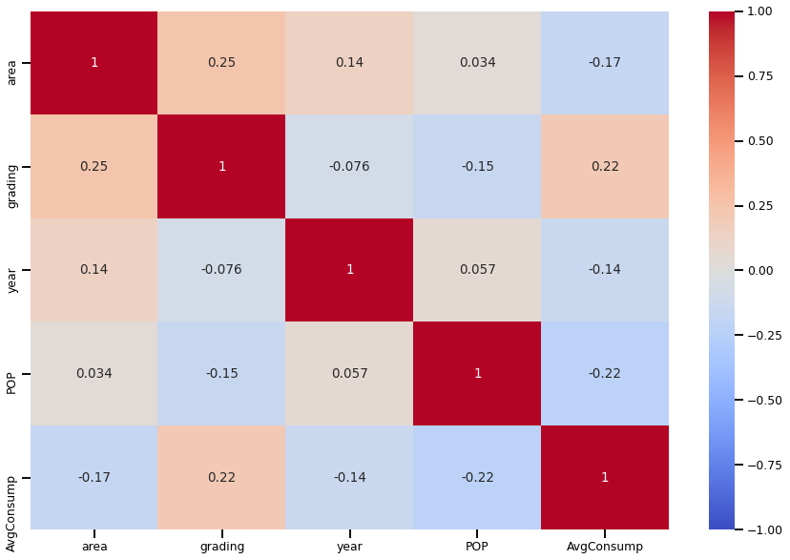
Data
Multivariate data resources are involved to build the model
Categories | Resources | Columns | Type
Shopping centers | Wrangled from Yingshang.com | building_area | float
 |  | rentable_area | float
 |  | built_year | integer
 | Baidu Map API | coordinate | geometry
Socioeconomics | Chinese socioeconomical year book of (2020) | population | integer
 |  | disposable_income | integer
 |  | consumption expense | integer
Urban environment | Purchased from third party | road | geometry
 |  | parks | geometry
 |  | subway_station | geometry
 |  | POIs | geometry
Social Media | Dianping.com (2022, March) | number of comments | integer
 |  | average consumption | integer

Slide 5
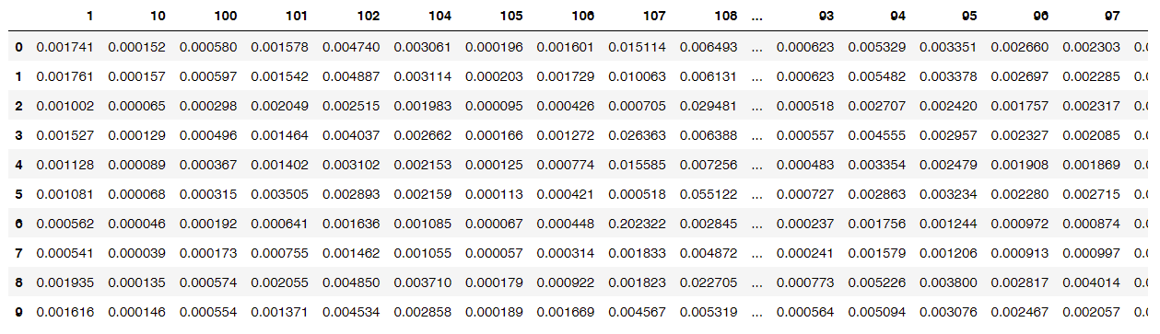
Method
Step1: Use gravity model to estimate number of customers of each shopping mall
Area and location of malls
input
Gravity Model
output
Matrix of customer share from each neighborhood and target shopping centers
Population by neighborhood
Distance matrix
Part of Gravity model results
Note: Columns represents each neighborhood, row index is the ID of each shopping center

Slide 6
Method
Step2: Calculate annual cost and income with real estate financial formulas
Number of customers
Building Area
Annual Consumption
Operation Expense per square meter
Market Penetration Rate
input
input
Income
Formula
Operating Income –Operating expenses
=NOI(Net Operation Income)
Cost
Formula
If NOI<=0, the shopping center is classified as an asset with high operating loss risk(1)
Otherwise, it’s classified as with low operating loss risk(0)
output
Number of identified malls(X)
Two lists of malls with high risk and low risk

Slide 7
Method
Step3: Test the accuracy using actual operating data from social media
Average Consumption
*
Number of comments
Operating
Index
Subset [X] malls with smallest index as malls with high operating loss risk
output
List of malls with risk
List of malls without risk
Compare with
Model classify result
output
Accuracy

Slide 8
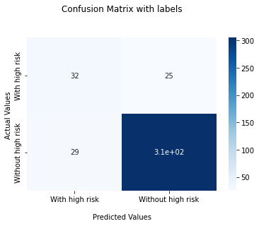
Results
The overall accuracy is good but still have improvement space
 | Accuracy
Overall | 86.22%
High operating loss risk | 56.14%
Low operating loss risk | 91.34%
57 out of 392 shopping centers
306

Slide 9
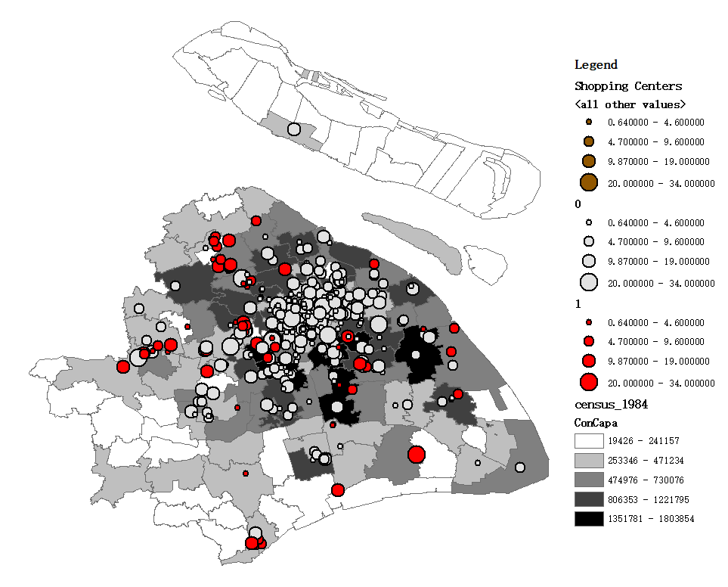
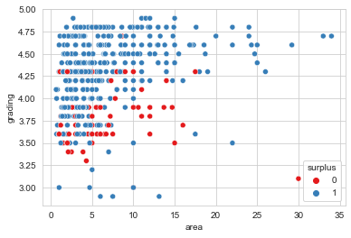
Data exploration
Surplus malls locate at suburban neighborhoods where consumption capacity is small
Malls with high loss risk are mostly located at suburban area where the total consumption capacity is small.
Others are located at urban center periphery where the market is competitive.
Shopping center area
Surplus-No
Area and customer grading distribution of identified malls
Surplus-Yes
Consumption Capacity

Slide 10
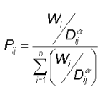
Next steps
Model improvement Identify shopping centers with redevelopment potential
Model improvement
Consider location effects in gravity model by Wi adjustment
Accuracy comparison
Entropy weight method
Quantify location value
Regression model
Identify outliers with high location value but low operating value(high risk of operating loss)
Shopping centers with redevelopment potential
Pij = the probability of consumer j shopping at mall i.
Wi = a measure of the attractiveness of each mall i.
Dij = the distance from consumer j to store or site i.
Operating Value

Slide 11
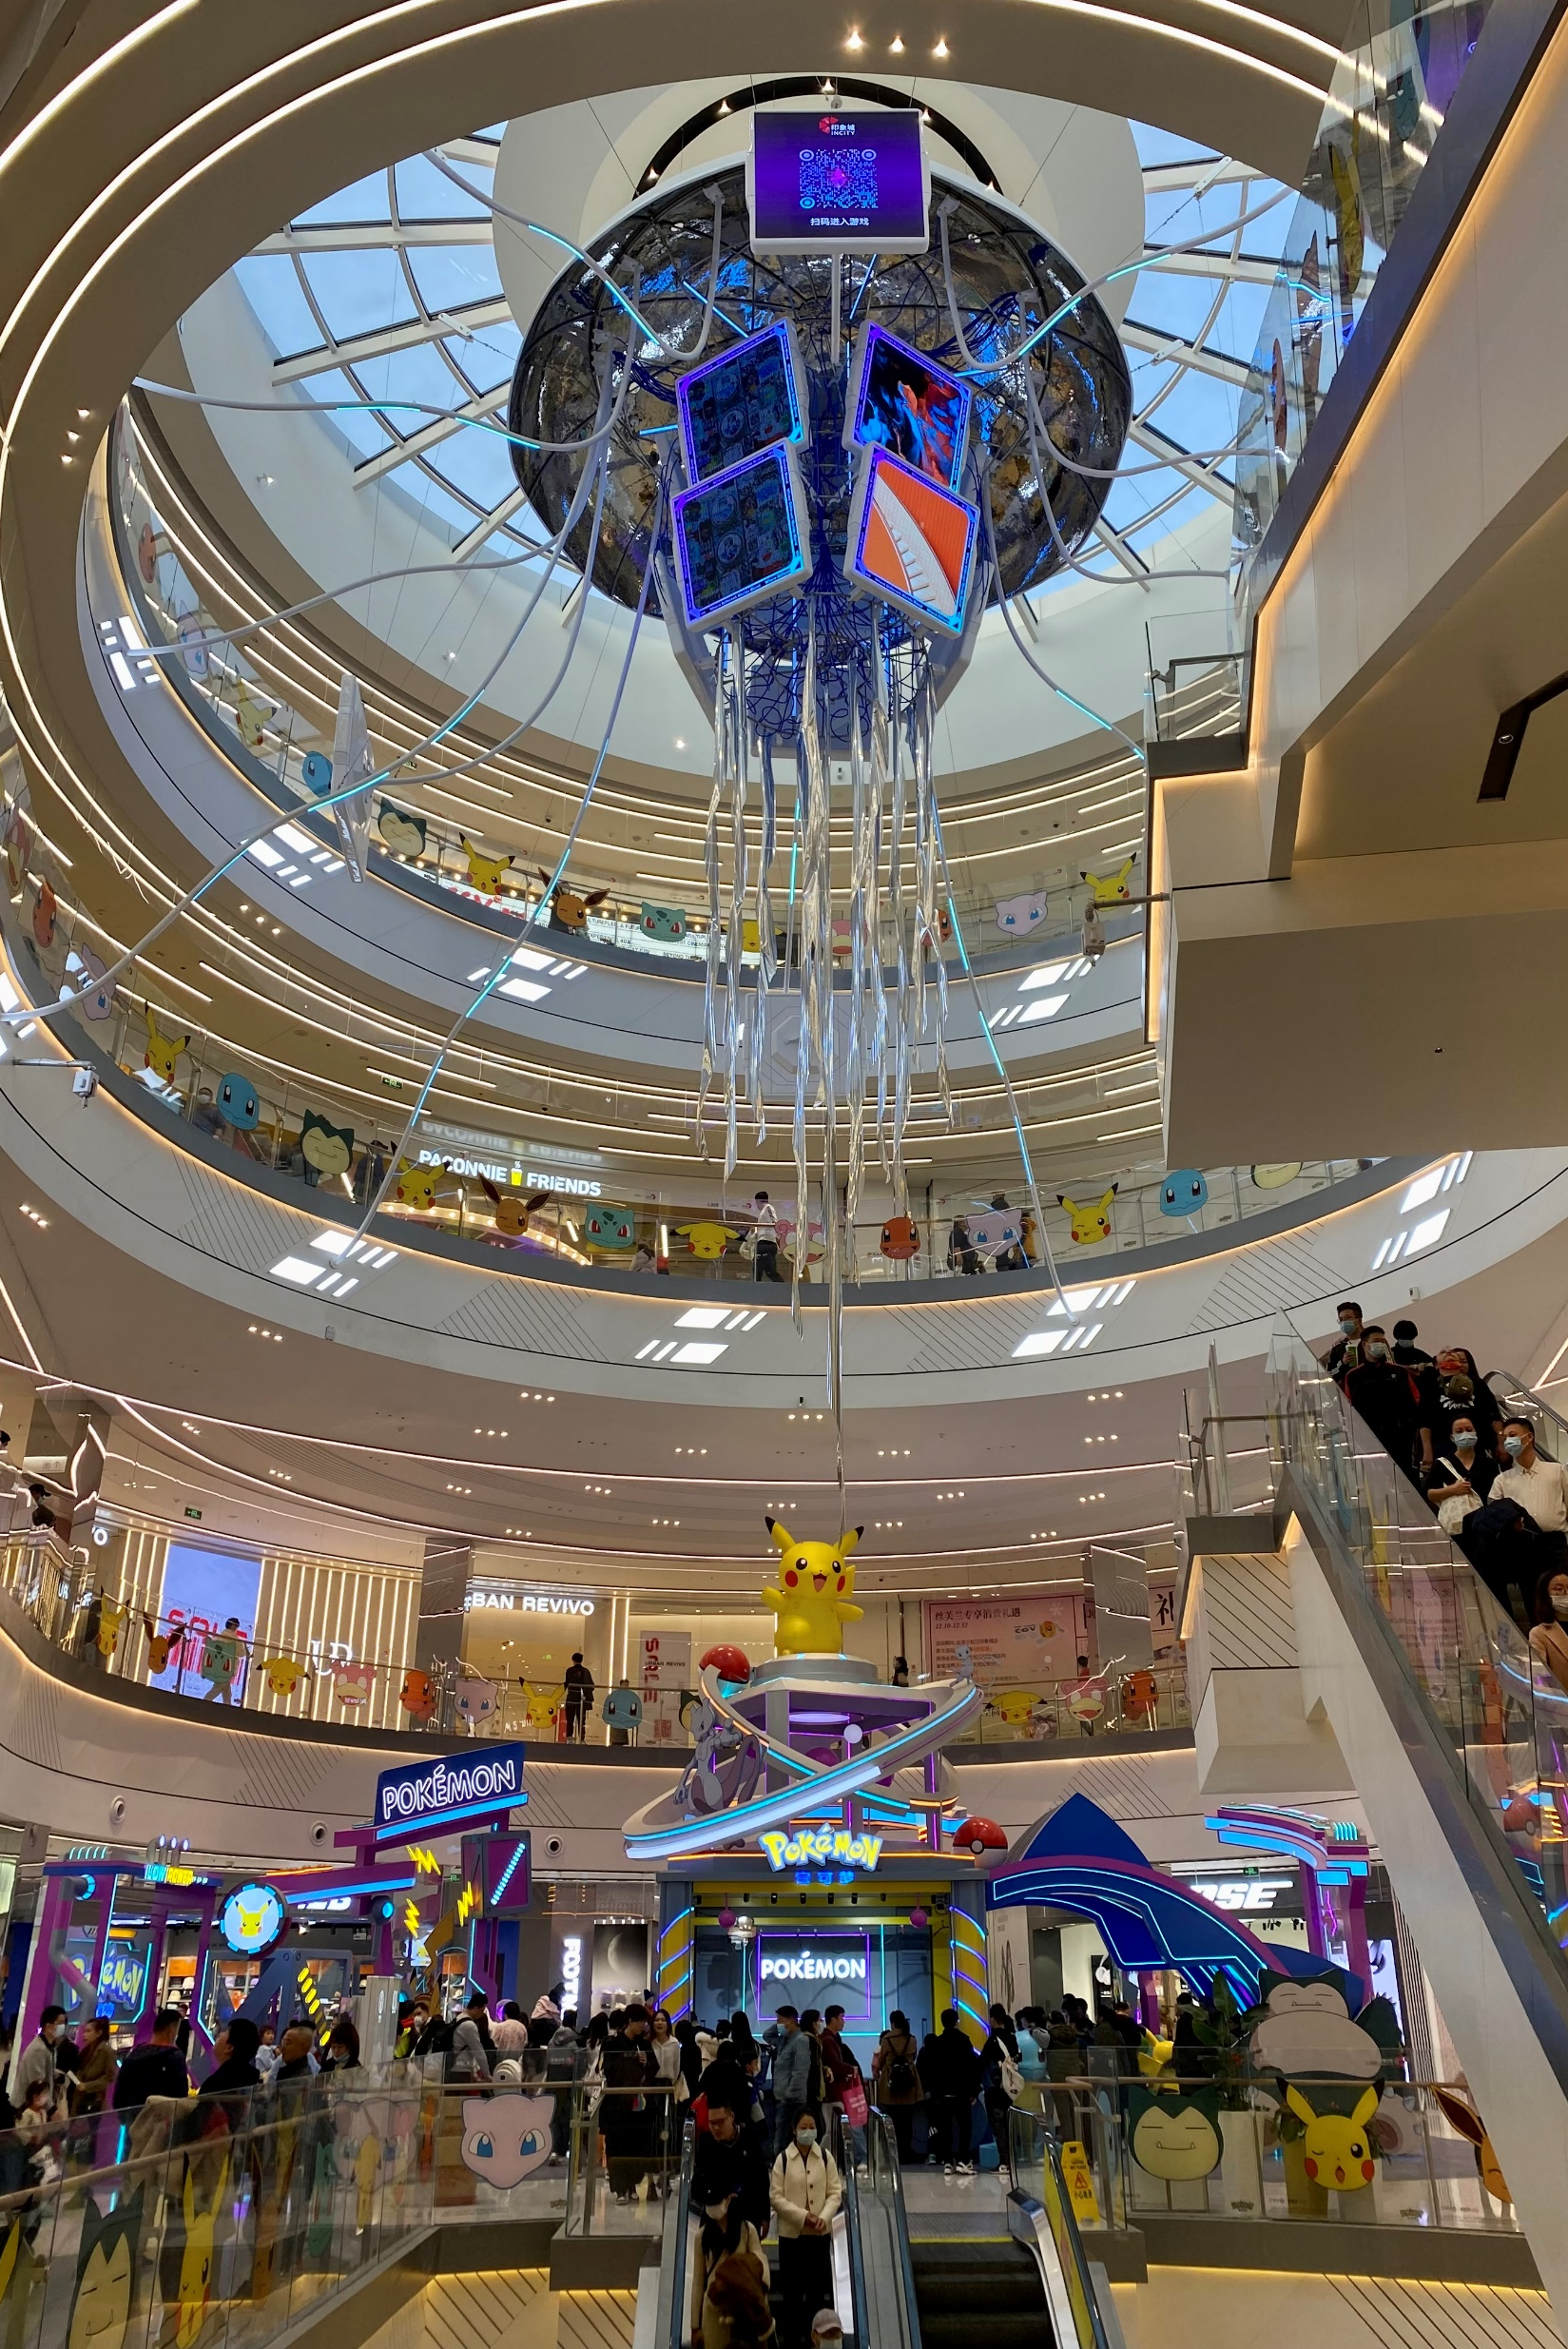
Thank you!
Q&A

